Slide 1
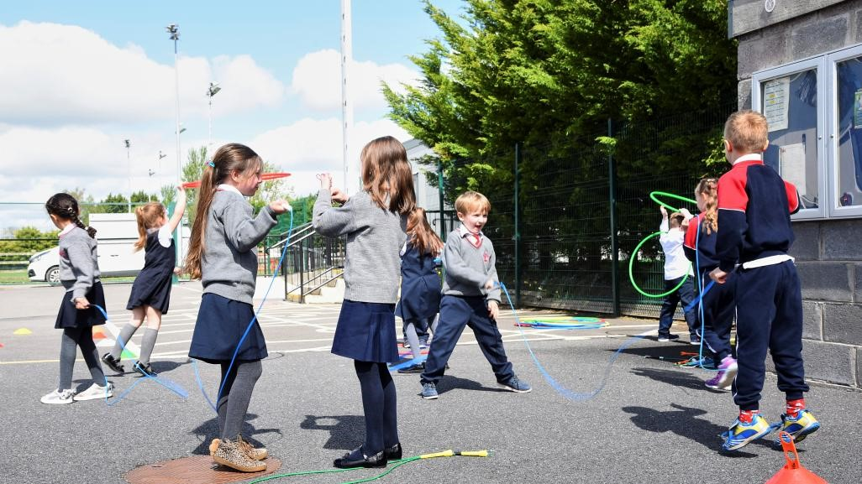



Bord Oideachais agus Oiliúna Chiarraí
An Scoil Náisiúnta Phobail
Seimineár Gréasáin – an Múnla
Community National Schools
Informational Webinar on the CNS model

Slide 2






Schedule
  Welcome
  Presentation on the Community National School
  by Ann O’Dwyer Director of Schools
  Classroom Discussion
  with Pádraig Ó Donnabháin, Chairperson, and
  Catherine Barry, Principal, Two Mile CNS
  Questions and Answers

Slide 3

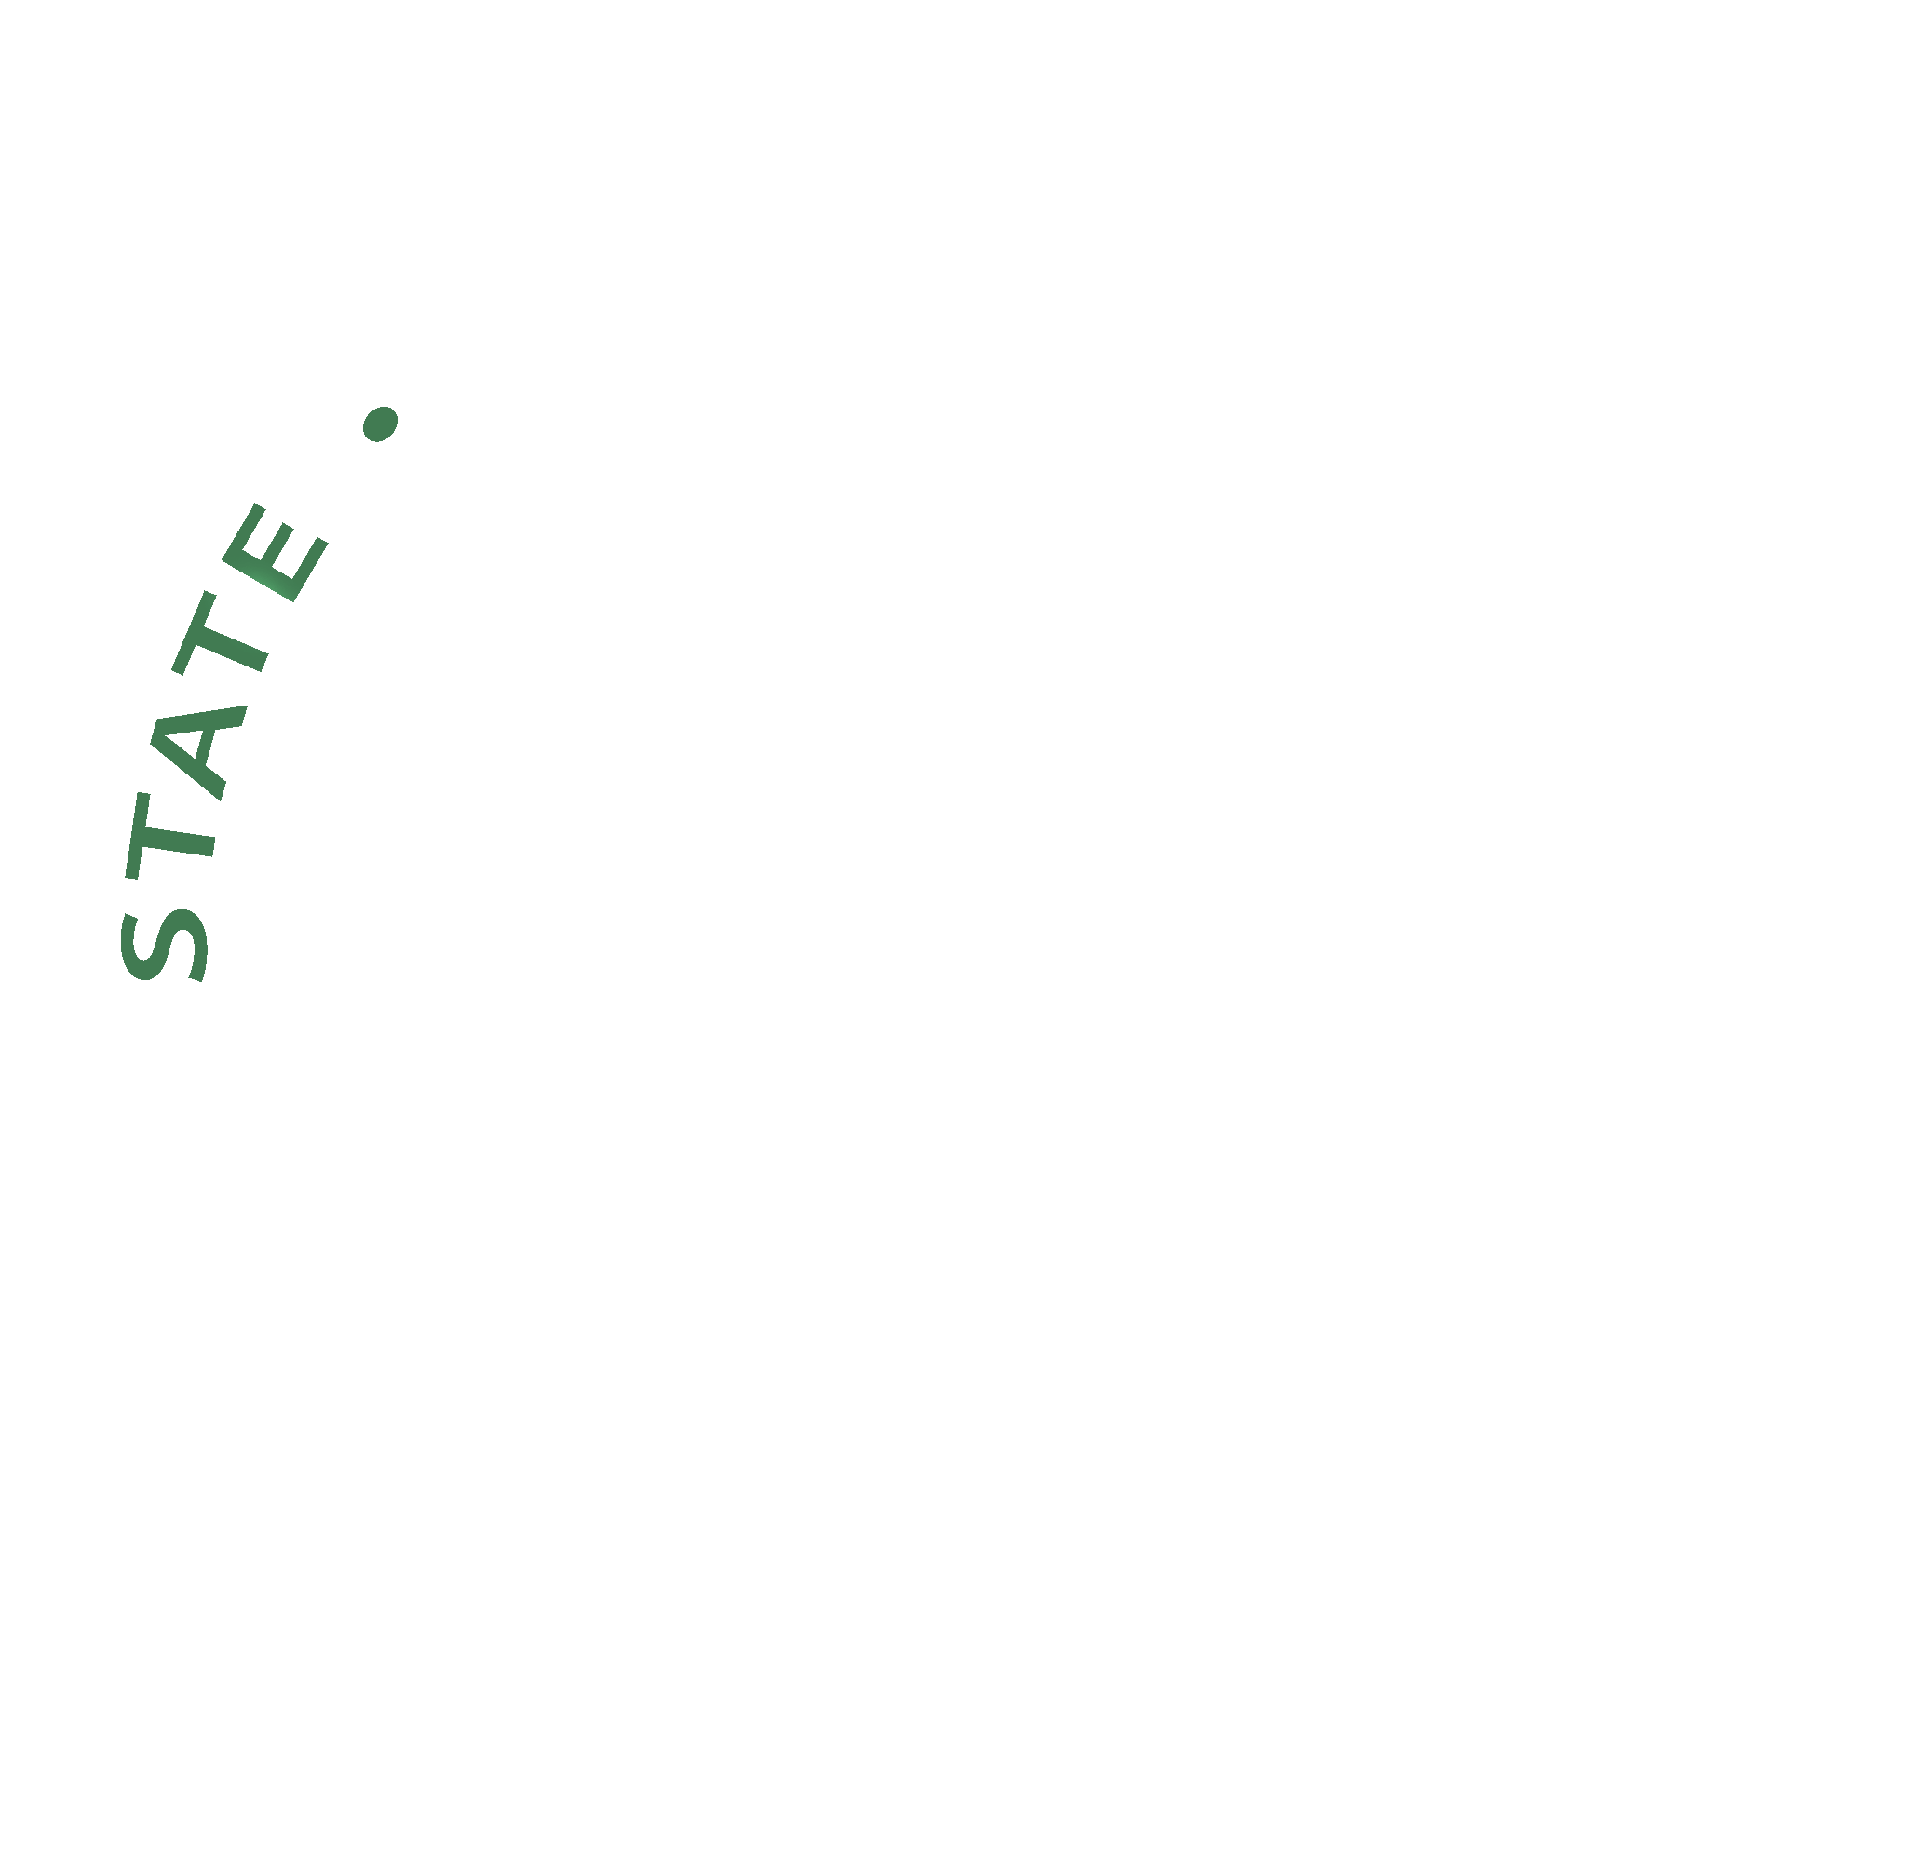








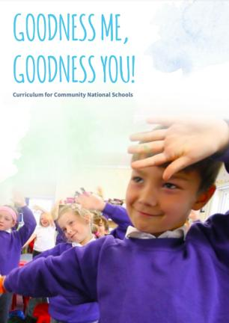
What are Community National Schools?

Slide 4
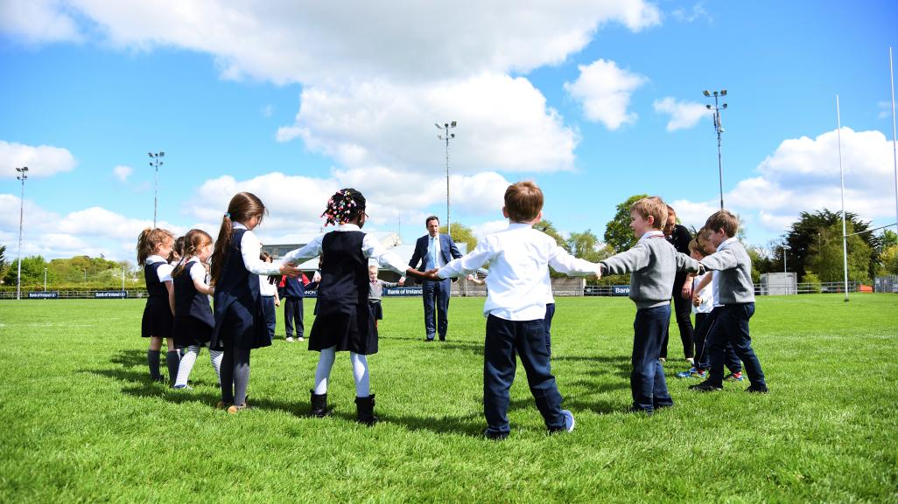
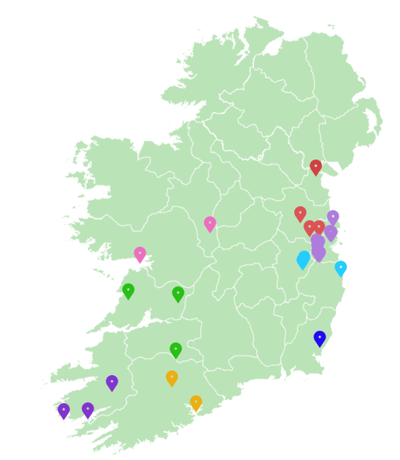
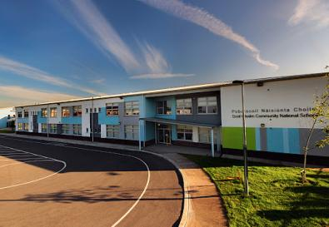
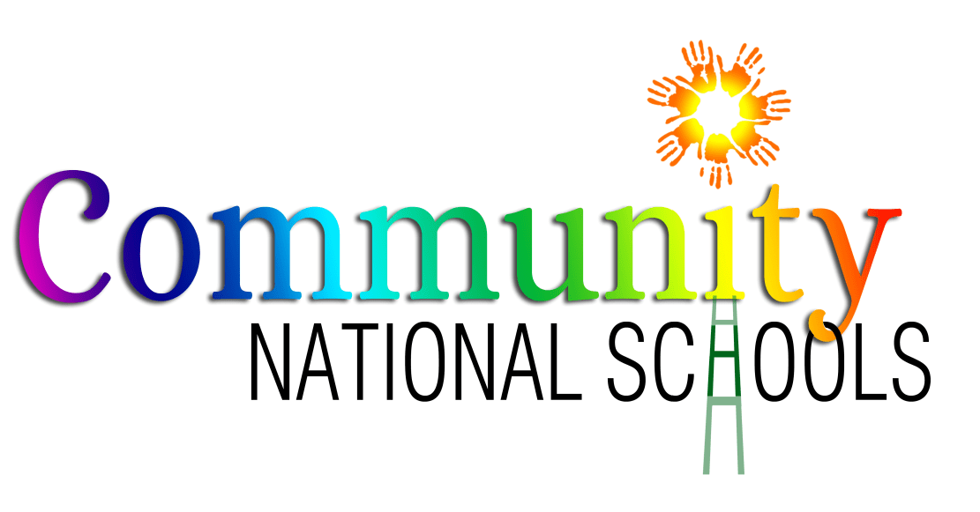

The Establishment and Growth of CNSs
CNS model established in 2007
First CNS opened in 2008 in West Dublin
CNSs are a growing model of primary education
There are currently 27 CNSs across 8 ETBs
New CNSs open in areas of demographic growth
(14 to date)
Others open through transfer of school patronage
(13 to date)
Programme for Government sets target of 400 Community National Schools by 2030

Slide 5
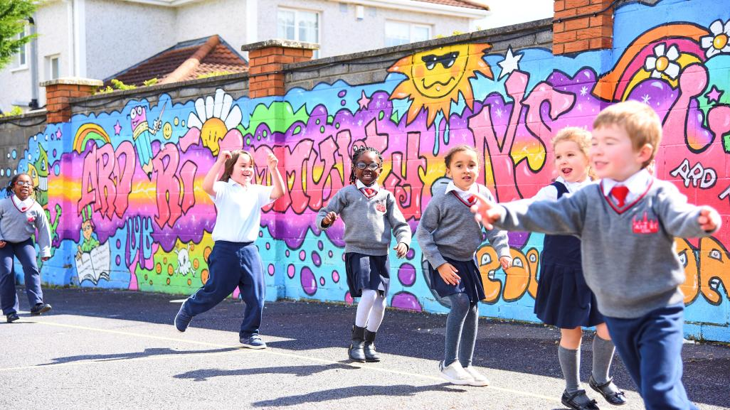

The Growth of the CNS Model
2008
First CNS opens
2009-2018
13 CNSs open
2019
7 schools transfer patronage to CNS
2 new CNSs open
2020
2022
2 new CNSs open
2 schools transfers
1 school to transfer patronage to CNS

Slide 6
The Growth of the CNS Model in Kerry ETB
2017
Two Mile CNS opens as a result of patronage transfer
2019
Tahilla CNS opens following patronage transfer
Scoil an Ghleanna SNP opens following patronage transfer
2022
Kerry ETB facilitate webinar of the CNS model

Slide 7
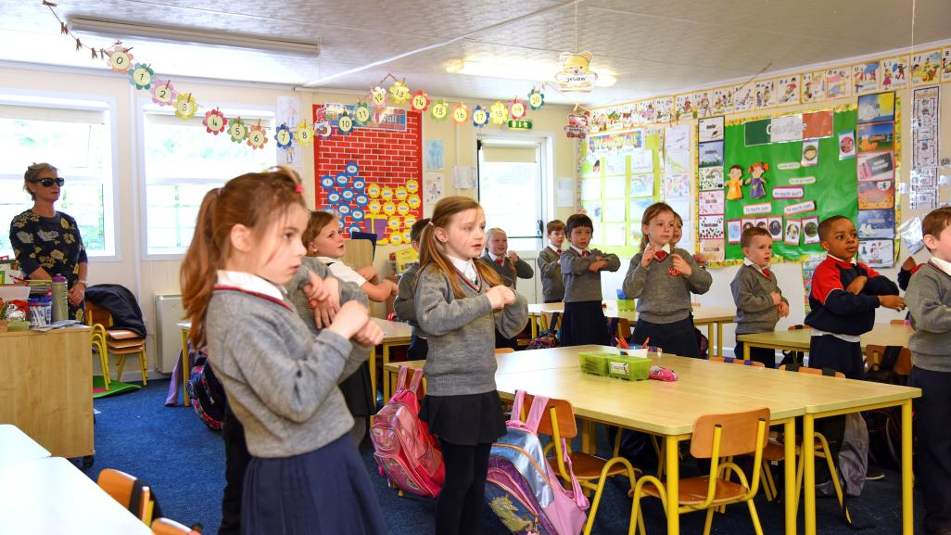
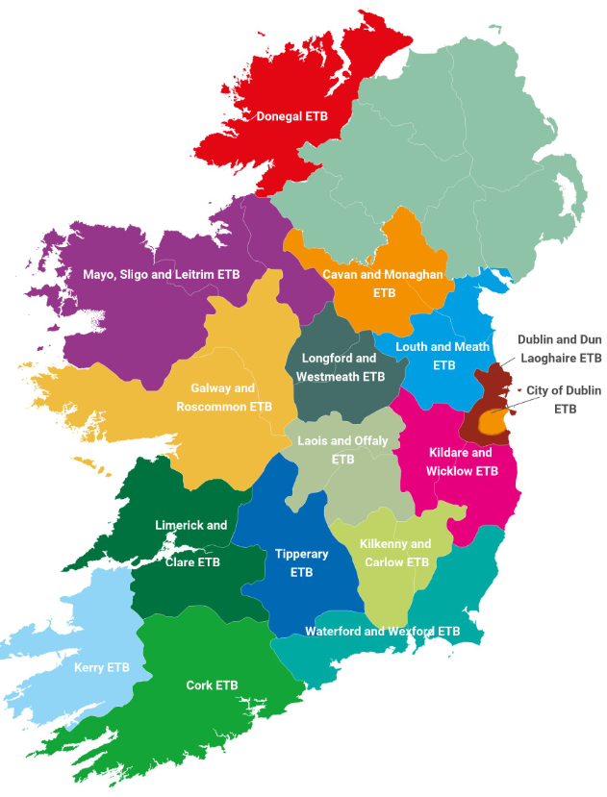
ETBs and Community National Schools
ETBs are the patrons of Community National Schools
ETBs are state bodies who provide primary, post-primary, youthwork and further education and training
ETBs have a reputation for inclusive, innovative and high quality education
ETBs provide a broad range of supports to their schools;
  Patronage/ethos
  Governance
  Financial
  Human Resources (HR)
  Capital and Buildings
  Information Technology (IT)
  Health and Safety
  Child Protection
  Principals Network
This positively impacts on the children an families attending CNSs, allowing school leaders to focus on their primary task of caring for the children and leading teaching and learning.

Slide 8
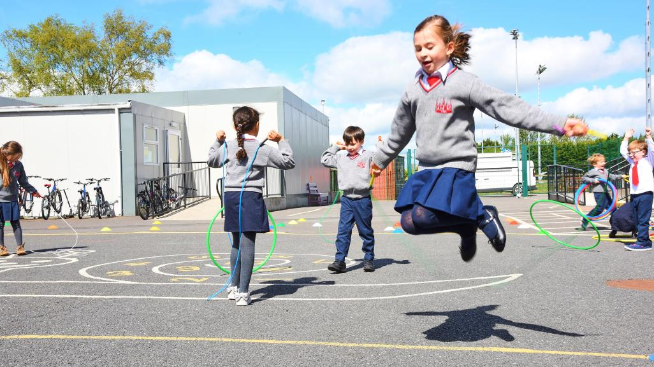
Kerry ETB: A Quick Glance*
38 locations
2,800 students
11,000 FET Learners
1,000 staff
€66 million budget per annum
*All figures to be taken as circa

Slide 9
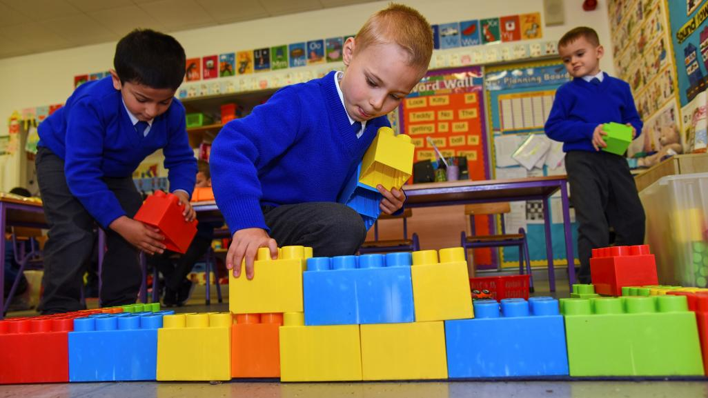

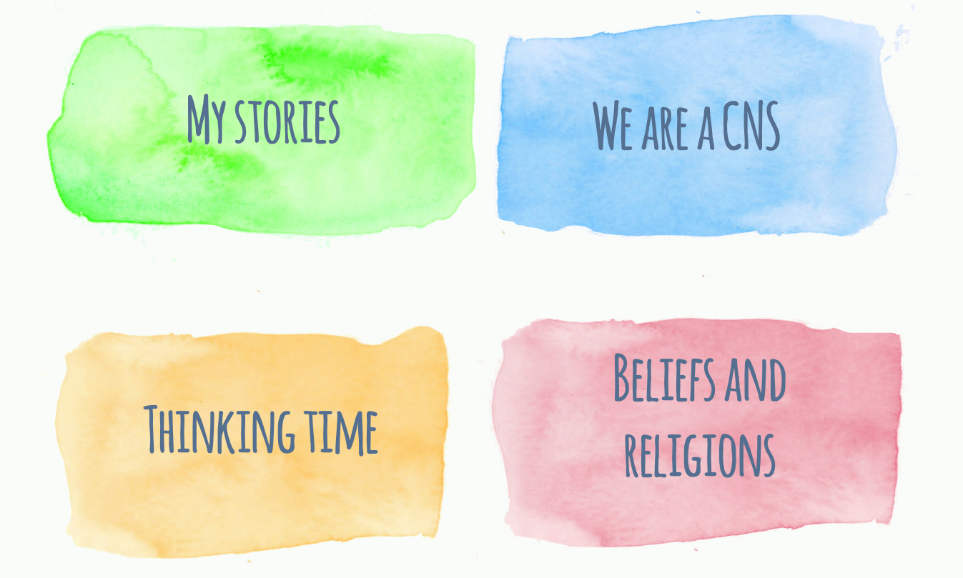
What is Goodness Me, Goodness You!?
GMGY is the patrons’ curriculum for CNSs
Development by the NCCA
Goodness Me, Goodness You! (GMGY) is a multi-belief and values education curriculum
GMGY aims to increase children’s sense of identity and belonging to their family, school, local community and wider world
GMGY is taught for 2.5 hrs each week through explicit and integrated lessons
Through GMGY, children encounter four strands:
  My Stories - identity and belonging
  We Are A CNS – values-led education
  Thinking Time - philosophy for/with children
  Beliefs and Religions - multi-denominational RE

Slide 10
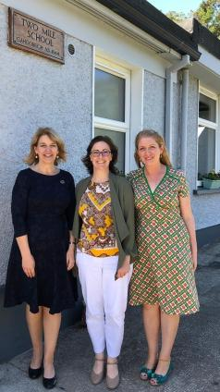
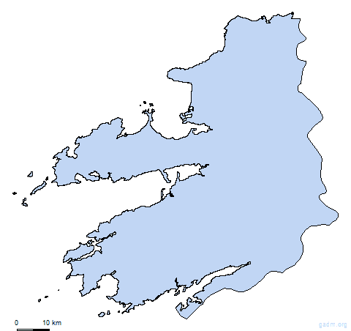
Kerry ETB Community National Schools
Kerry ETB Community National School Principals pictured (right) at the opening of Two Mile Community National School new extension in 2019
Two Mile Community National School
Scoil an Ghleanna Pobal Scoil Náisiúnta
Tahilla Community National School
L to R
Catherine Barry, Principal, Two Mile CNS
Máire de Cogáin, Principal, Tahilla CNS
Sorcha Ní Chatháin, Príomhoide, Scoil an Ghleanna SNP

Slide 11
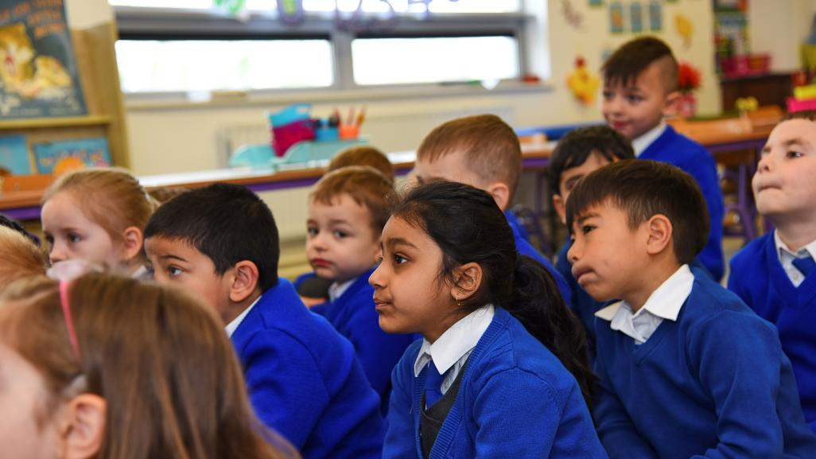
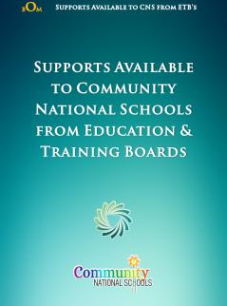
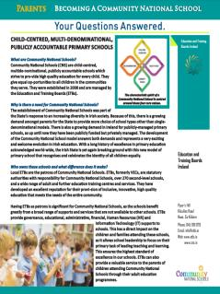

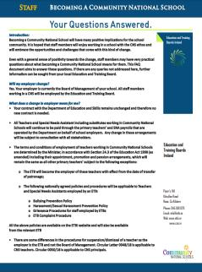
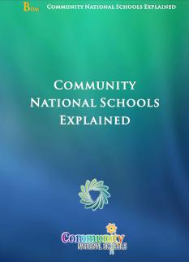
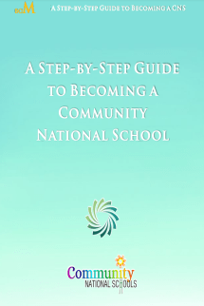
More Information? Visit https://cns.ie/become-a-cns/

Slide 12
